Slide 1


Basic Details of the Team and Problem Statement
PS Code: PS06
Problem Statement Title: AI-powered Pest and Disease Identification App
Team Name: Mystics
Team Leader Name: Niladri Roy
Institute Code (AISHE): TMSL
Institute Name: Techno Main Salt Lake
Theme Name: Agriculture

Slide 2
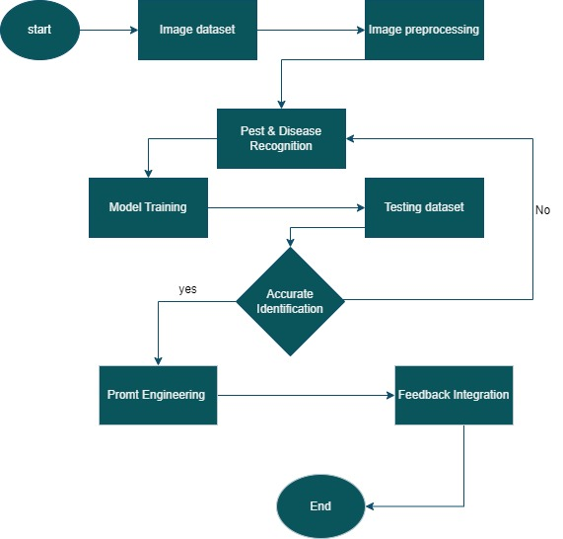




Idea/Approach Details
Add process flow chart or simulated image of prototype or any relevant image related to your idea
Describe your idea/Solution/Prototype here:
We are looking for a solution to identify the pests and diseases by creating an application that will serve as a platform for the farmers to get rid of financial loss caused by the damage of crops by pests and diseases. The prototype will function as follows:
----------------------------------------------------------
Problem Statement
Challenges faced by farmers in identifying pests and diseases
Economic impact of misidentification or late detection
Limitations of traditional identification methods
Our Solution
Introduction to the AI-powered app
Key features and functionalities
How the app works (brief explanation of the AI technology used)
After identifying the disease, our application will provide remedies and cure to the crops by employing Prompt Engineering
Describe your Technology stack here:

Slide 3
Idea/Approach Details
Describe your Dependencies / Show stopper here
Dependencies:
Quality and Size of Training Data:
Dependency: The performance of AI models heavily relies on the quality, diversity, and size of the training dataset. A robust dataset covering various crops, pests, diseases, and environmental conditions is essential.
Machine Learning Algorithms:
Dependency: Selection and implementation of appropriate machine learning algorithms (such as deep learning models for image recognition) tailored to the specific requirements of pest and disease identification.
Image Processing and Computer Vision Libraries:
Dependency: Reliable libraries and frameworks for image processing and computer vision are crucial for accurately analyzing and interpreting crop images uploaded by users.
Integration with Databases:
Dependency: Seamless integration with comprehensive databases containing information on pests, diseases, crop varieties, and treatment recommendations to enhance accuracy and relevance of diagnostic results.
Show Stoppers:
1.Lack of Training Data:
Show Stopper: Insufficient or poor-quality training data can hinder the development of accurate AI models, leading to unreliable pest and disease identification results.
2.Algorithm Performance Issues:
Show Stopper: Inadequate selection or implementation of machine learning algorithms may result in suboptimal performance, affecting the app's ability to provide accurate and timely diagnoses.
Describe your Use Cases here
Farmers can use the app to quickly identify pests, diseases, and nutrient deficiencies in crops by capturing and uploading photos. Early detection allows for timely intervention, reducing crop losses.
Based on image analysis and data from integrated databases, the app provides precise recommendations for treatment strategies, including optimal pesticide use and organic alternatives, tailored to specific crop issues.
Beyond diagnosis, the app serves as an educational resource, providing information about identified pests and diseases, their lifecycle, and effective management practices. This empowers farmers with knowledge to implement sustainable farming methods.
Through machine learning algorithms, the app learns from user interactions and feedback, improving its accuracy in identifying pests and diseases over time. This iterative improvement ensures that the app remains effective and up-to-date.

Slide 4
Team Member Details
Team Leader Name: Niladri Roy
Branch (Btech/Mtech/PhD etc): BCA Stream (ECE, CSE etc): BCA Year (I,II,III,IV):III
Team Member 1 Name: Debraj Sen
Branch (Btech/Mtech/PhD etc): BCA Stream (ECE, CSE etc):BCA Year (I,II,III,IV): III
Team Member 2 Name: Sudipta Nahal
Branch (Btech/Mtech/PhD etc): BCA Stream (ECE, CSE etc): BCA Year (I,II,III,IV): III
Team Member 3 Name: Aindrila Bhattacharya
Branch (Btech/Mtech/PhD etc): BCA Stream (ECE, CSE etc): BCA Year (I,II,III,IV):III
Team Member 4 Name: Aditya Ghosh
Branch (Btech/Mtech/PhD etc): BCA Stream (ECE, CSE etc): BCA Year (I,II,III,IV): III
Team Member 5 Name: Arnab Dutta
Branch (Btech/Mtech/PhD etc):BCA Stream (ECE, CSE etc): BCA Year (I,II,III,IV): III
Team Mentor (Optional) Name: Dr.Mauparna Nandan
Category (Academic/Industry): Academic Expertise (AI/ML/Blockchain etc): AI Domain Experience (in years): 2

